Slide 1
Large-scale irregular
undulations of the
ionosphere as
observed by the
Falkland Islands
SuperDARN radar
S. E. Milan, A. Grocott, M. Lester,
T. K. Yeoman, M. P. Freeman, and G. Chisham

Slide 2
Auroral scatter
Subauroral electrodynamics
South Atlantic Anomaly
Vertical coupling
Gravity waves
Orographic gravity waves
Mesospheric winds and tides
steve.milan@ion.le.ac.uk

Slide 3
First light, 14th Feb 2010
Expected removal of
electronics, Sept 2011
Very modest amounts
of ionospheric scatter
Ionospheric motions
steve.milan@ion.le.ac.uk

Slide 4
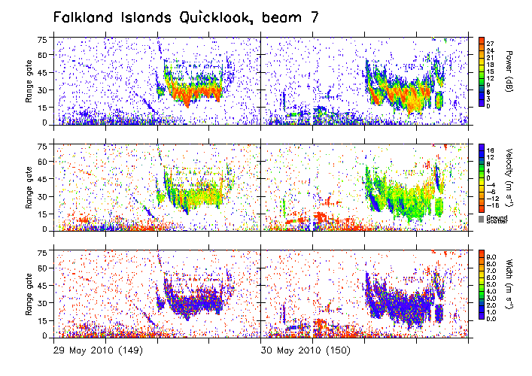
steve.milan@ion.le.ac.uk

Slide 5
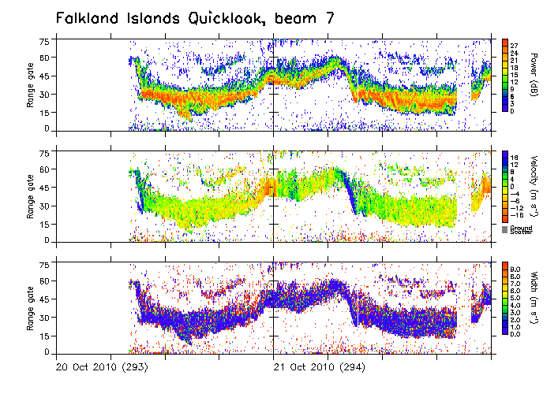
steve.milan@ion.le.ac.uk

Slide 6
Wot, no interferometer?
Milan et al. (1997)

Slide 7
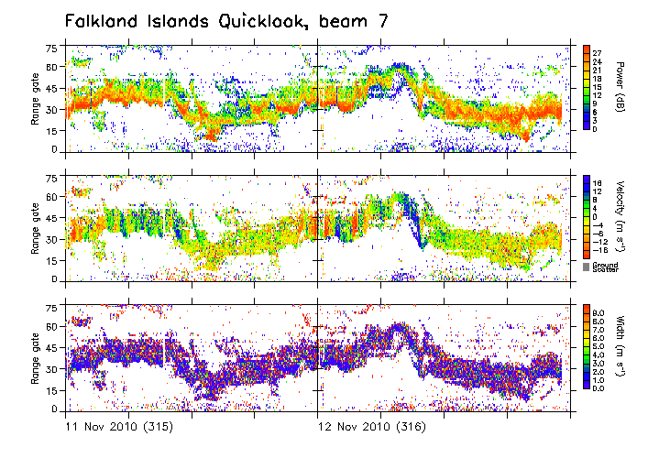
steve.milan@ion.le.ac.uk

Slide 8
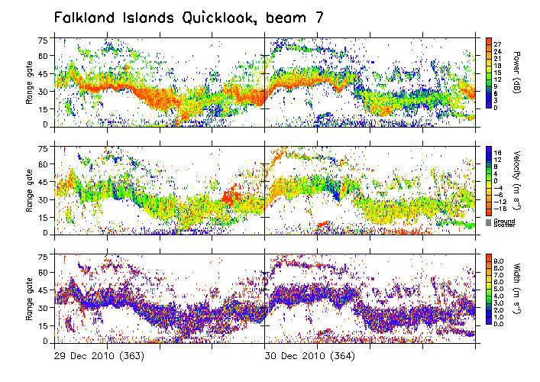
steve.milan@ion.le.ac.uk

Slide 9
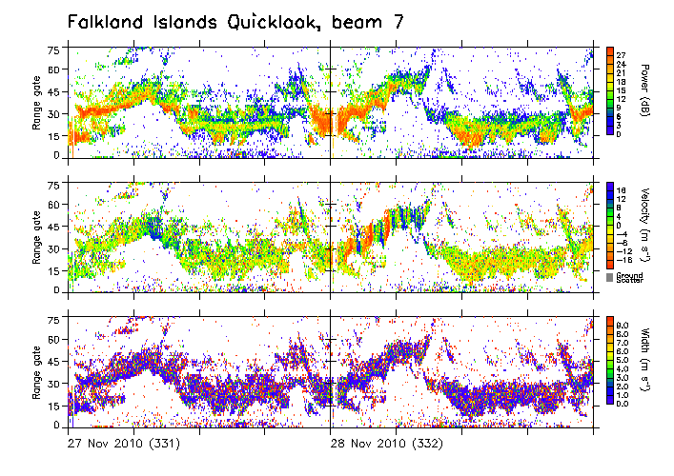
steve.milan@ion.le.ac.uk

Slide 10
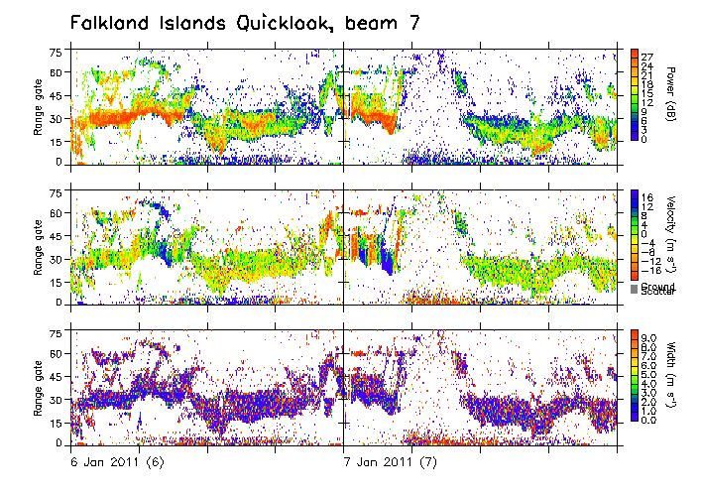
steve.milan@ion.le.ac.uk

Slide 11
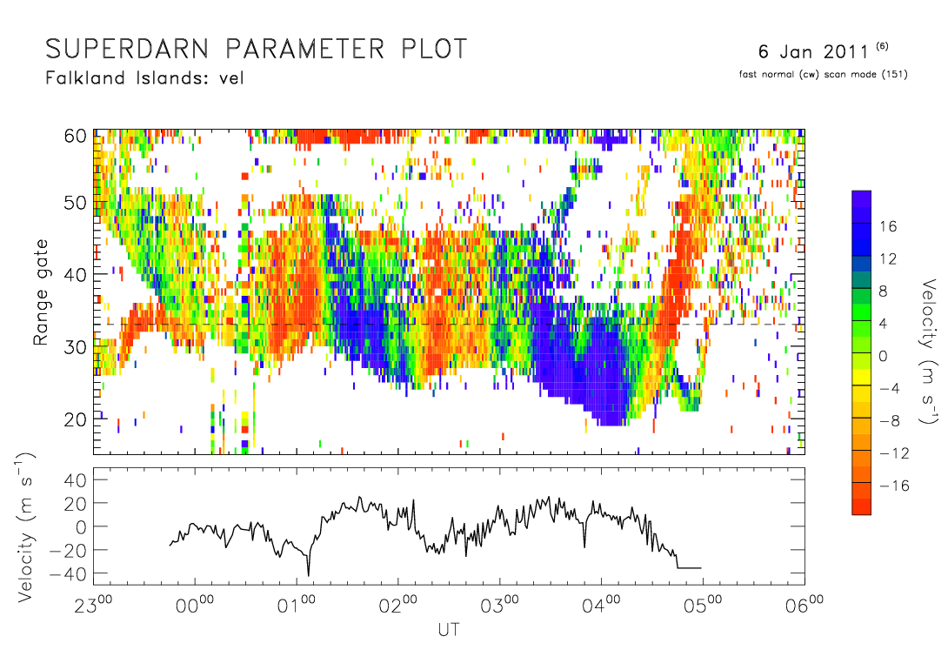
steve.milan@ion.le.ac.uk

Slide 12
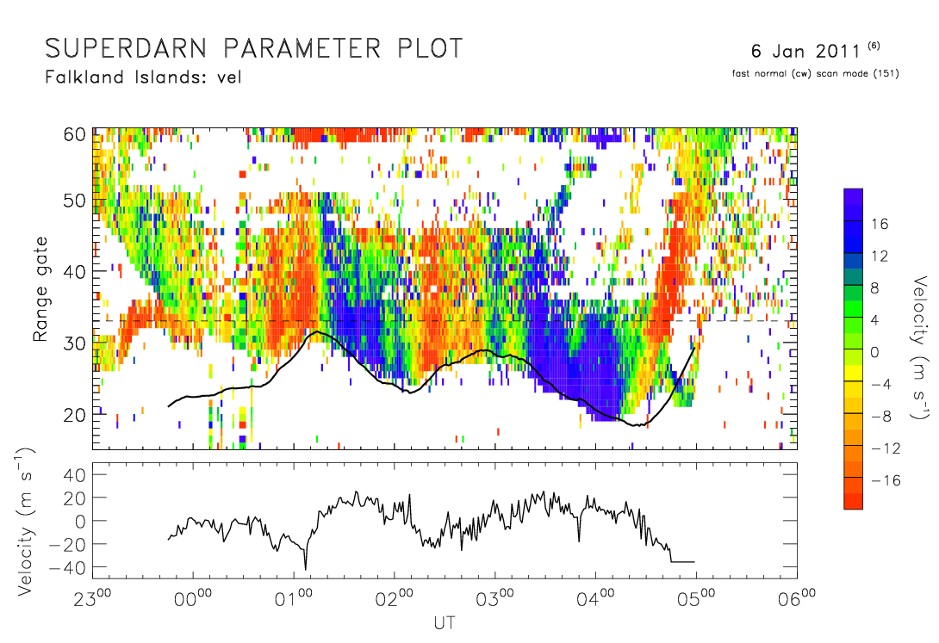
steve.milan@ion.le.ac.uk

Slide 13
×5
steve.milan@ion.le.ac.uk

Slide 14
φ_{c}
h
skip ray
Δ
Skip distance
radar operating frequency f_{r}
ionospheric critical frequency f_{c}
Secant law
steve.milan@ion.le.ac.uk

Slide 15
φ_{c}
h
skip ray
Δ
Skip distance
skip distance S
proportional to h
radar operating frequency f_{r}
ionospheric critical frequency f_{c}
Secant law
steve.milan@ion.le.ac.uk

Slide 16
φ_{c}
h
skip ray
Δ
Range gate
a particular range gate corresponds to a ray with a fixed path length
steve.milan@ion.le.ac.uk

Slide 17
φ_{c}
h
skip ray
Δ
R
Range gate
a particular range gate corresponds to a ray with a fixed path length
as the ionosphere lifts, the ray footprint moves
towards the radar; the motion relative to surface
features produce a Doppler shift apparently
away from the radar
steve.milan@ion.le.ac.uk

Slide 18
skip distance
ground range
φ_{c} is associated with skip ray, Δ appropriate for a particular range gate
At further ranges, Δ decreases and the ratio increases
This decrease in Doppler shift with range is observed
Observations consistent with ascent and descent of
the ionosphere with an amplitude of ±50 km
steve.milan@ion.le.ac.uk

Slide 19
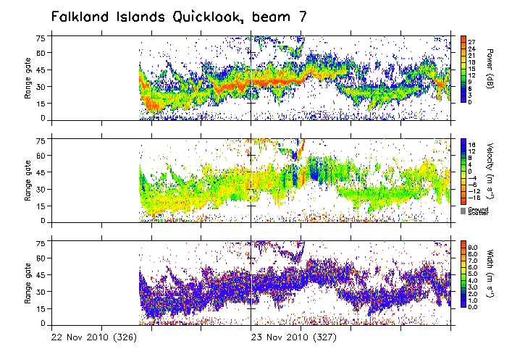
steve.milan@ion.le.ac.uk

Slide 20
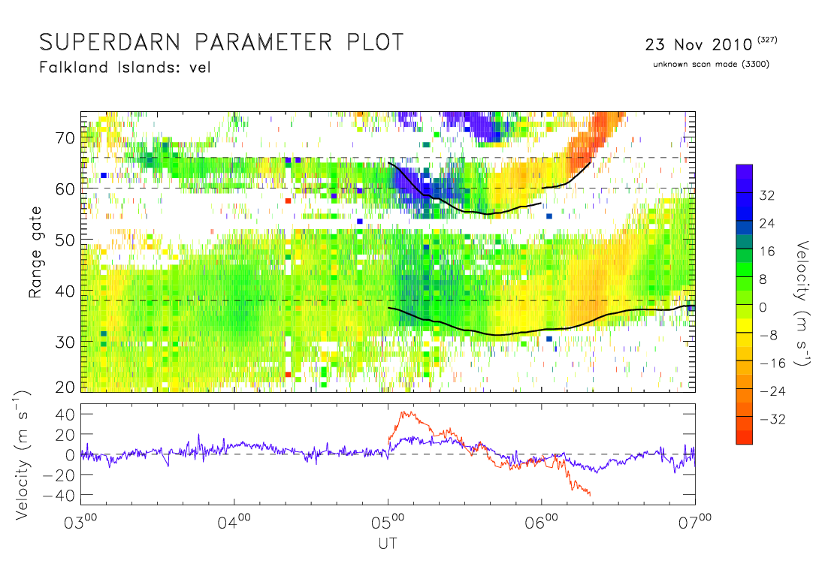
steve.milan@ion.le.ac.uk

Slide 21
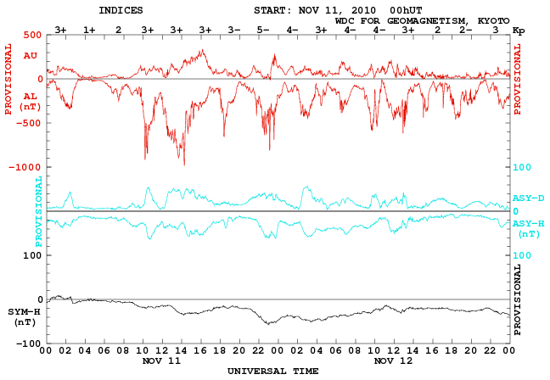
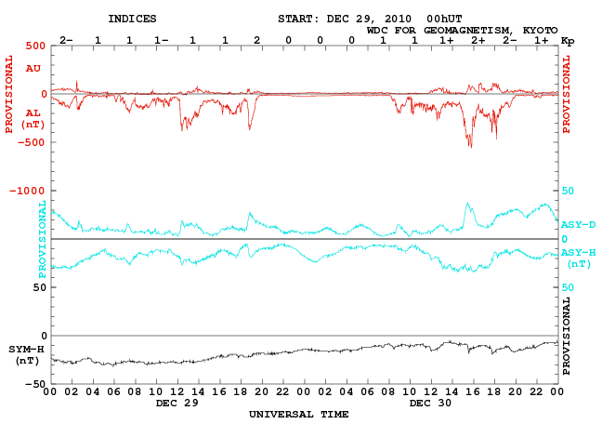

Slide 22
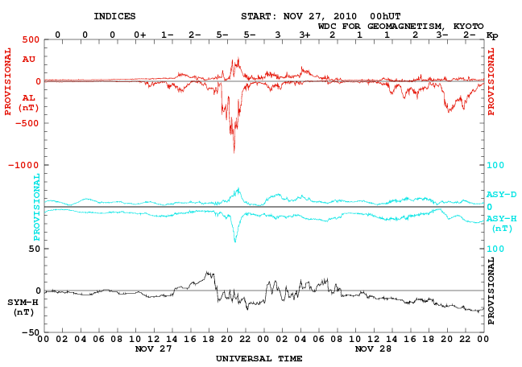
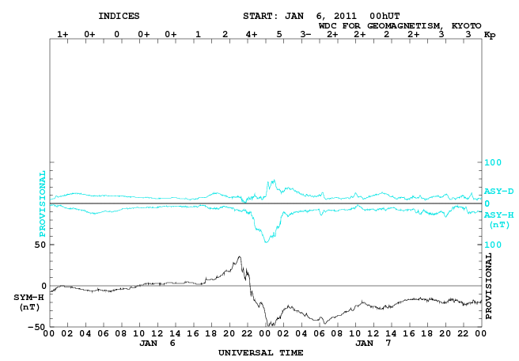

Slide 23
Conclusions
FIR observes irregular undulations of the ionosphere;
ionospheric motions may be ±50 km in altitude
(test with ray tracing?)
They appear predominantly at night; more needs to
be done to understand the propagation mode
(e.g. ray tracing)
Tend to occur as pairs of positive-then-negative,
towards-then-away motions
In contrast, most gravity waves are observed on
the dayside
The appearance of undulations may be related to
geomagnetic activity, in two cases
possibly associated with solar wind shocks
steve.milan@ion.le.ac.uk

